Slide 1
Applied Imaging Concepts: An introduction to image processing and analysis
Sara Rolfe
8/26/19

Slide 2
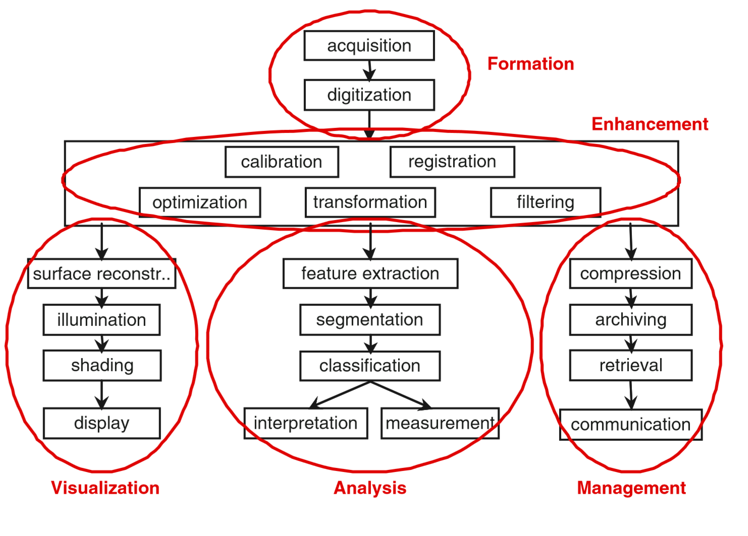
3D imaging conceptual workflow
Notes:
Image processing and analysis covers 4 main areas including formation (capturing the image), visualization, analysis, taking quantitative measurements or abstract interpretations from an image, and management, which includes storage, transmission, and accessing the images

Slide 3
Outline
Image Formation
Coordinate systems
Digitization and quantization
Resolution
Image Enhancement
Filtering and transformations
Registration
Image Analysis
Segmentation
Image Visualization
Surface reconstruction
Display

Slide 4
What is a Coordinate System?
v₃
A coordinate system for a three-dimensional space is a point O called the origin along with three linearly independent vectors v₁, v₂, and v₃.
Linearly independent here means no two of the vectors are parallel and the three vectors do not all lie in the same plane.
O
v₁
v₂
Notes:
In three dimensional space, the coordinate system consists of an origin and three linearly independent vectors (not parallel or lying on the same plane)

Slide 5
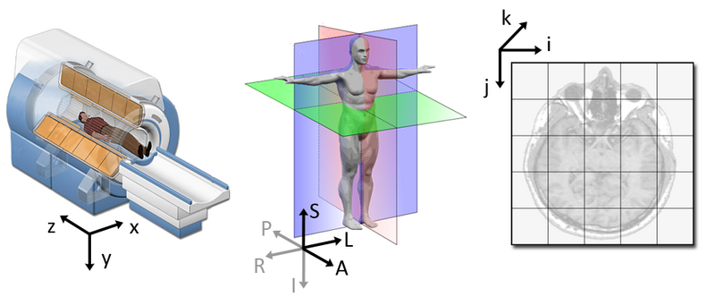
Coordinate Systems
World Coordinate
System
Anatomical Coordinate
System
Image Coordinate
System
Notes:
There are a variety of coordinate systems used in medical and biomedical imaging that meet these criteria, the most common of which are...

Slide 6
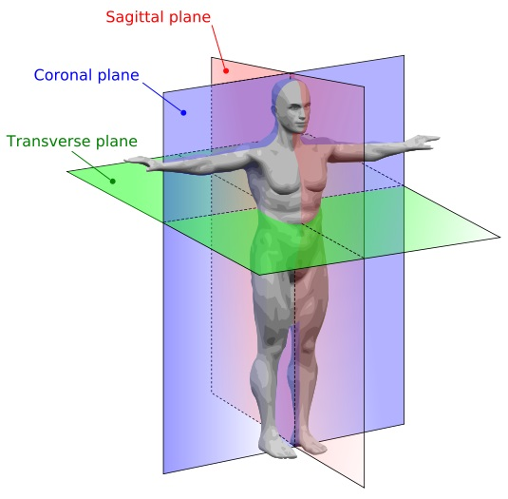
Anatomical coordinate system
This space consists of three planes to describe the standard anatomical position of a human:
axial plane is parallel to the ground and separates the head (Superior) from the feet (Inferior)
coronal plane is perpendicular to the ground and separates the front from (Anterior) the back (Posterior)
sagittal plane separates the Left from the Right
This coordinate system is fixed with respect to the scan table and the object or subject being scanned. Different medical applications use different definitions of this 3D basis
Notes:
The most important model coordinate system for medical imaging techniques is the anatomical space. This space consists of three planes to describe the standard anatomical position of a human:
However, different medical applications use different definitions of this 3D basis

Slide 7
Anatomical coordinate system: RAS vs LPS
Superior
Superior
Anterior
Posterior
Left
Right
Right
Left
Posterior
Anterior
Inferior
Inferior
RAS (Right, Anterior, Superior): 3D Slicer
LPS (Left, Posterior, Superior): DICOM images, ITK toolkit

Slide 8
Anatomical coordinate system: RAS vs LPS
Superior
Superior
Anterior
Posterior
Left
Right
Right
Left
Posterior
Anterior
Inferior
Inferior
RAS (Right, Anterior, Superior): 3D Slicer
LPS (Left, Posterior, Superior): DICOM images, ITK toolkit
Notes:
Similar with the first two axis flipped. Necessary to know which basis an image is referenced on.

Slide 9
The IJK Image Coordinate System
k
Every medical scanner has its own coordinate system called the IJK coordinate system. The
IJK coordinate system represents the actual rectangular prism of data that is scanned, instead of the position of the scan table
j
-i
i
-j
-k

Slide 10
Coordinate System Conversion
We frequently need to convert between
coordinate systems, such as RAS and IJK.
The mapping from one coordinate system to
another is a 3D affine transformation: a
sequence of transformations consisting of a
shear, a reflection, a rotation, a scaling, and a
translation.

Slide 11
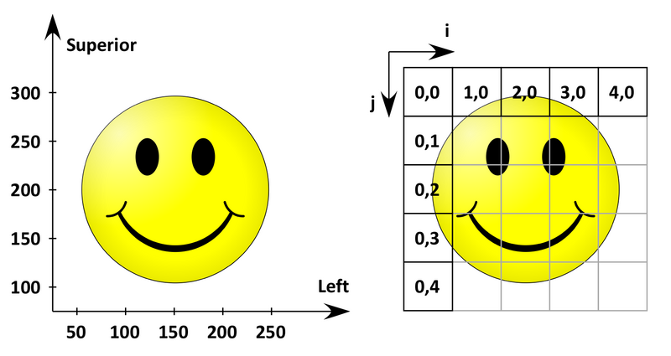
What do all of these mean
LPS Anatomical space
Image Coordinate System

Slide 12
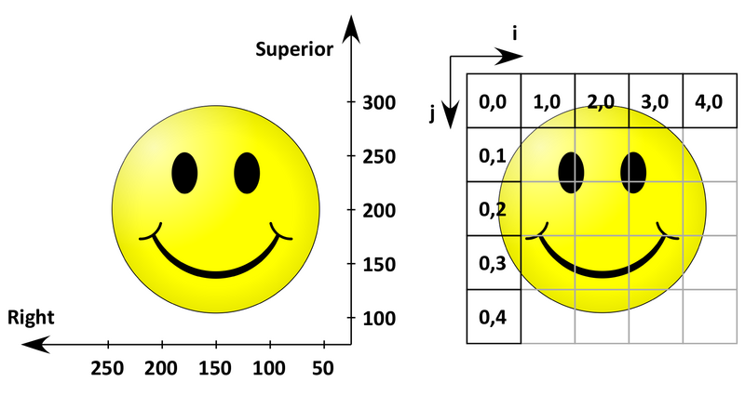
What do all of these mean
RAS Anatomical space
Image Coordinate System
Notes:
When converting between coordinate systems it is essential to know the reference frame to interpret the image

Slide 13
What do all of these mean
KNOW YOUR DATA AND SOFTWARE
RAS Anatomical space
Image Coordinate System

Slide 14
What is an image?
An image is a sampling of a continuous field using a discrete grid

Slide 15
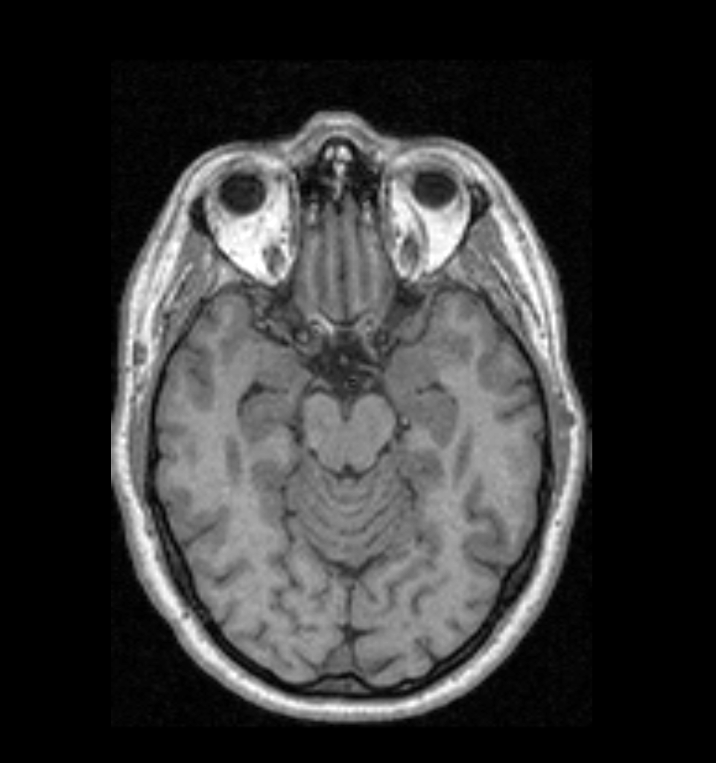
What is an image?
Spacing (x)
Spacing (y)
Origin (x,y)
Notes:
An image is defined with an origin, and regular intervals of spacing in each dimension

Slide 16
What is an image?
Spacing (x)
Pixel Index
[0,7]
[4,7]
[0,5]
[0,3]
Spacing (y)
[0,1]
Origin (x,y)
[0,0]
[1,0]
[2,0]
[3,0]
[4,0]
[5,0]

Slide 17
Digitization
Digital image processing implies the discrete nature of images.
Values in an image are samples on a pixel (2D) or voxel matrix (3D)
Digitization applies to both sampling (resolution) and the value range (quantification)

Slide 18
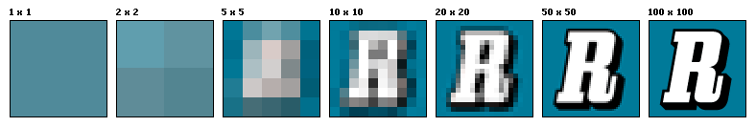
Resolution
Resolution is the capability of sensor to observe or measure the smallest object clearly with distinct boundaries. MicroCT scanners have resolutions from sub-micron range to 100s of microns (1000 micron = 1 mm).
Pixel is unit of digital image. How big of a physical structure a pixel represents depends on the resolution (i.e. resolution and pixel size are inversely proportional).
Notes:
Resolution is the result of digitization in spatial sampling. The closer in space the samples are, the better the resolution, or ability to observe small structures clearly.
The size of a pixel in 2d is calculated from the spatial resolution. In this example, the same space is sampled with pixel resolutions from 1x1 to 100x100.

Slide 19
Resolution in 3D
Similar to pixel, voxel is a unit of digital volume:
Resolution in each dimension is not necessarily identical: That’s especially true for human imaging, where the sampling in Z is a lot coarser than X and Y (i.e. they take far fewer slices, but within a slice you see everything you need to see in high-detail). In this case the voxels are said to be ANISOTROPIC. If all dimensions are identical then the voxels are ISOTROPIC

Slide 20
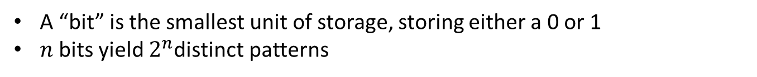
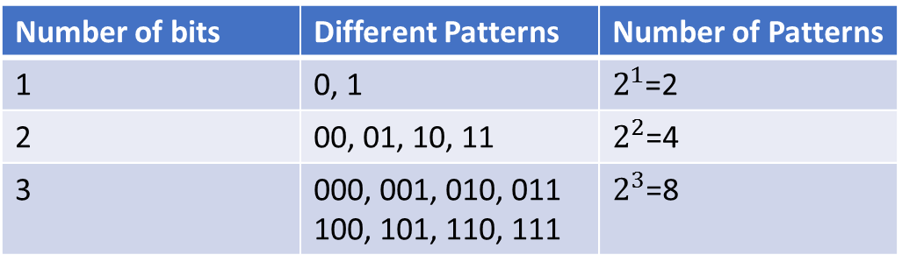
Bits and Bytes
A “bit” is the smallest unit of storage, storing either a 0 or 1
$n$bits yield $2^{n}$distinct patterns
Number of bits | Different Patterns | Number of Patterns
1 | 0, 1 | =2
2 | 00, 01, 10, 11 | =4
3 | 000, 001, 010, 011 100, 101, 110, 111 | =8
One byte = collection of 8 bits
All storage is measured in bytes
Kilobyte, KB, ~ 1 thousand bytes
Megabyte, MB, ~ 1 million bytes
Gigabyte, GB, ~ 1 billion bytes
Terabyte, TB, ~ 1 trillion bytes

Slide 21
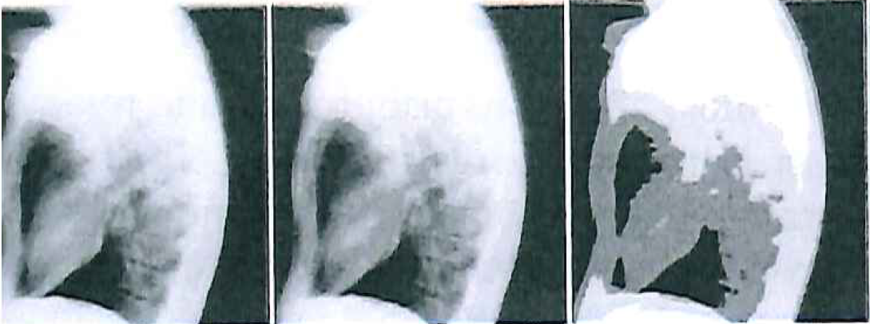
Quantization
Quantization refers to the digitization of the value range
Grayscale image: 8 bits (256 possible states)
Color image: 24 bits (16,777,216 possible states)
CT scans: 12 bits (4,096 possible states)
6 bit (64 values)
3 bit (8 values)
2 bit (4 values)
Notes:
Lateral chest radiograph shown with 6 bit, 3 bit, and 2 bit quantization, which translates to 64, 8 and 4 grayscale values.

Slide 22
Quantization and image size
You have a CT scan of a human subject that is 256 pixels wide, 256 pixels high, and consists of 256 slices and the image depth is 16 bit.
How big is this data set?
Notes:
Quantization, both in the spatial resolution and the range of values, impacts the amount of data needed to represent an image. If for example we have an image that is…

Slide 23
Quantization and image size
You have a CT scan of a human subject that is 256 pixels wide, 256 pixels high, and consists of 256 slices and the image depth is 16 bit.
How big is this data set?
8 bit = 1 byte
256 x 256 x 256 x (16/8) = 33,554,432 Bytes
~ 32MB

Slide 24
So what do those mean to me?
As a general rule, you need at least 4-6 times as large RAM than your dataset.
If you want to visualize your dataset in full resolution, you need a GPU that has at least 1.5 times as large VRAM than your dataset.
A typical high-resolution microCT dataset is
1024 x 1024 x 1024 in dimensions.
If image depth is 8 bit this = 1024MB or 1GB
So in case of 1GB volume, you need at least 6GB of RAM and a GPU with 1.5GB of VRAM.
Notes:
This is not a guarantee that you will have sufficient memory for a task, but it gives you an idea of when you might expect to see an out of memory error error.

Slide 25
Memory Limitations:
A 32 bit OS can only address 4GB of RAM regardless of how much physical RAM your computer has.
Memory fragmentation: The available memory isn’t contiguous, but consists of many small fragments. This results in out of memory errors the OS reports that the sufficient memory is available. This was a common issue on Windows platforms but has been improving.
Notes:
A couple of other limitations to keep in mind are that if you are using a 32 bit machine…

Slide 26
Image compression
Goal: Reduce the amount of data required to represent the information in a digital image
Can be lossy or lossless
Eliminates redundancy in the data:
Coding: optimize number of bits required to code information in image
Interpixel: exploit correlations between neighboring pixels
Psychovisual: discard data that is perceptually insignificant

Slide 27
What format NOT to use?
JPEG
Or any other lossy compression format. Why are we doing all this work if we are going to throw them out when we save?
Notes:
Even data that is not perceptually significant can still be important when using quantitative analysis. Avoid throwing away information.

Slide 28
Image enhancement
Image enhancements are low-level operations that are preformed without knowledge of the content of an image
Why?
Remove noise
Sharpen image, etc.
Examples
Histogram transformations
Convolution
Mathematical morphology
Registration

Slide 29
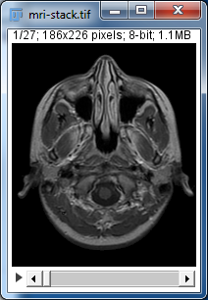
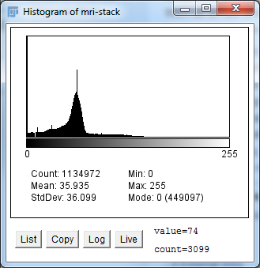
Image Histogram
An image histogram shows the frequency distribution of the pixel values (in this context grayscale) in a digital image. It plots the number of pixels for each tonal value.
Notes:
The image histogram is an important statistical tool that provides information about the content of an image. It plots a count of pixels for either each value or inside a range of values. The shape of a histogram provides information about the content of the image. For example, a histogram with a peak at a single value, representing an image with a single color, represents an image with no spatial information. A histogram that is spread out over a range of values represents an image more spatial information.

Slide 30
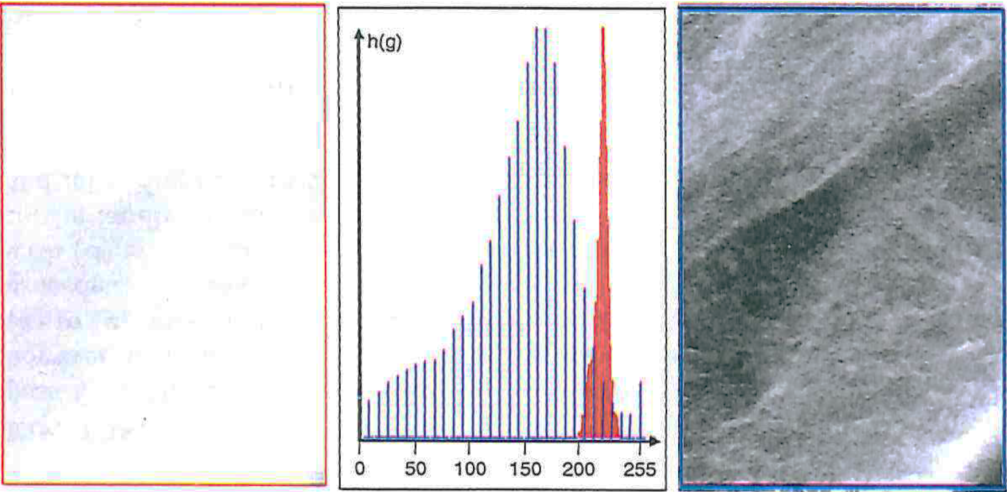
Histogram transformation
Simple pixel transforms can be defined using the histogram
In this example the gray scale values of the image in (A) are stretched, resulting in the improved contrast in (C)
A. Original image
B. Original and stretched histograms
C. Enhanced image

Slide 31
Image filtering
Modify the intensity values of a pixel based on a function of the intensity values from a local neighborhood around that pixel.
4
2
8
Function f(x)
4
36
41
19
1
31
44
Notes:
Another way to enhance an image without knowledge of the image content is to apply simple spatial filters to neighborhoods around pixels. In this example we take a pixel of interest, examine a neighborhood around that pixel and replace it with a function of the values in that neighborhood.

Slide 32
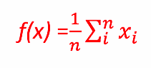
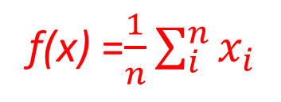
Image filtering
Modify the intensity values of a pixel based on a function of the intensity values from a local neighborhood around that pixel.
4
2
8
Function f(x)
4
36
41
19
1
31
44
f(x) =$\frac{1}{n}\sum_{i}^{n}{x_{i}}$
Mean filtering/ moving average
Removes sharp features

Slide 33
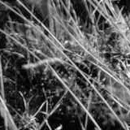
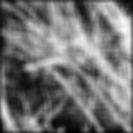
Smoothing with a mean filter

Slide 34
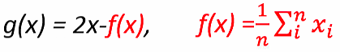
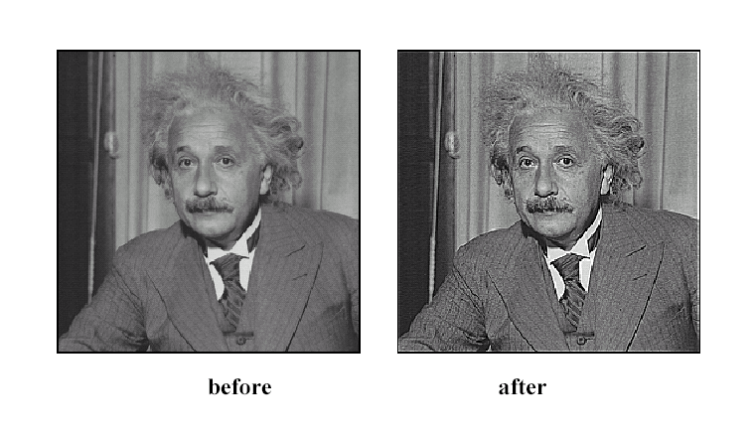

Sharpening
Sharpening function g(x) = 2x-f(x),
f(x) =$\frac{1}{n}\sum_{i}^{n}{x_{i}}$

Slide 35
Convolution
Filters that use a linear combination of pixels in a spatial neighborhood are often defined as convolution with a template, or “kernel”
The weights of the template are determined by the filter’s kernel and determine the effect of the filter
The kernel is shifted to each pixel location
From the previous mean filter example, the kernel is:
Notes:
These type of spatial filters can be defined as a product of the mathematical operation of convolution. Defined as the integral of two functions after one function is reversed and shifted

Slide 36
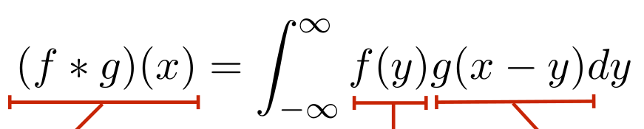
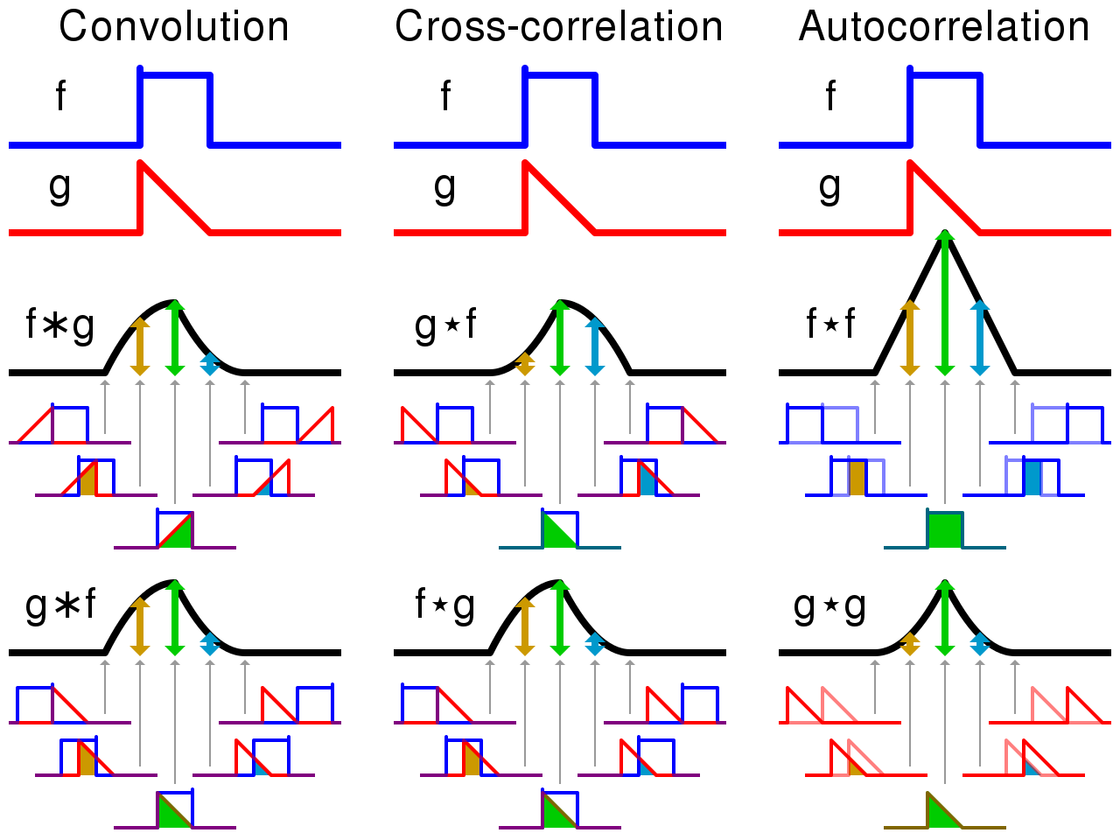
Convolution in 1D
notice the flip
filtered signal
input signal
filter
Notes:
Mathematical definition of convolution: integral of two functions after one function is reversed and shifted

Slide 37
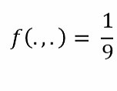
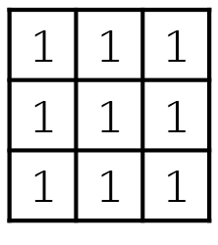
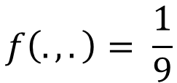
Convolution
Filters that use a linear combination of pixels in a spatial neighborhood are often defined as convolution with a template, or “kernel”
The weights of the template are determined by the filter’s kernel and determine the effect of the filter
The kernel is shifted to each pixel location
From the previous mean filter example, the kernel is:
$$f\left(.,.\right)= \frac{1}{9}$$
Notes:
In general, the convolution templates are mirrored across the axis, and their properties are defined by the type of kernel chosen.
In the previous example, the convolution kernel is defined here.

Slide 38
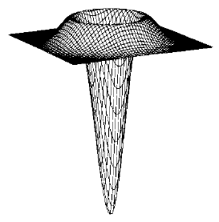

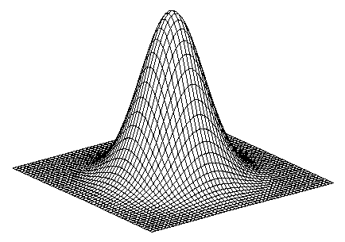
Common kernel choices
1
2
1
Sobel
0
1
0
Vertical Gradient
Horizontal Edge
(absolute value)
0
0
0
0
0
0
-1
-2
-1
0
-1
0
0
0
0
Horizontal Gradient
0
1
0
LaPlacian of Gaussian
2D edge detection
-1
0
1
1
-4
1
0
0
0
0
1
0
Gaussian smoothing
Weight contribution by nearness
Notes:
In practice, there are some common kernel choices with known properties that can be applied with predictable results without needing to go into the mathematics of convolution.

Slide 39
Mathematical morphology
Set of logical operations performed primarily on binary images
Frequently used to clean up shapes after pixel–based segmentation
Binary mathematical morphology consists of two basic operations
Dilation: based on logical AND
Erosion: based on logical OR
and several composite relations
Closing: dilation followed by erosion
Opening: erosion followed by dilation
Skeleton: erosion with various structuring elements
Notes:
Another approach to filtering is based on mathematical morphology
Set of general tools for improving the results of binary segmentation. An important post-processing step after more sophisticated segmentation techniques

Slide 40
Structuring Elements
A structuring element is a shape mask used in
the basic morphological operations.
They can be any shape and size that is
digitally representable, and each has an origin.
box
hexagon
disk
other

Slide 41
Dilation
Dilation expands the connected sets of 1s of a binary image.
It can be used for
1. growing features
2. filling holes and gaps

Slide 42
Erosion
Erosion shrinks the connected sets of 1s of a binary image.
It can be used for
1. shrinking features
2. Removing bridges, branches and small protrusions

Slide 43
Image Registration
Registration can be used to obtain a correspondence between images such that a change in measured dimensions can be quantified.
The moving image will be resampled into the fixed image coordinate system
y
y’
y
x
Space Transform
x
x’
Physical coordinates of fixed image
Physical coordinates of moving image
The space transformation can be rigid or non-rigid (more on this later)
Notes:
An approximation of two or more images so that the differences between the two can be quantified
One image is defined as the fixed image and the moving image is resampled into the coordinate system of the moving image

Slide 44
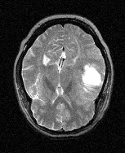
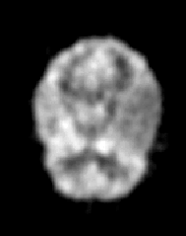
Multimodal registration
MRI-T2
PET
Space Transform
128 x 128 pixels
256 x 256 pixels
Images from the project: “Retrospective Image Registration Evaluation”, NIH, Project No. 8R01EB002124-03, Principal Investigator, J. Michael Fitzpatrick, Vanderbilt University, Nashville, TN.

Slide 45
Multimodal registration
MRI-T2
PET
Transform
128 x 128 pixels
Do not register images in pixel space
Pixel spacing needs to be specified
256 x 256 pixels
Images from the project: “Retrospective Image Registration Evaluation”, NIH, Project No. 8R01EB002124-03, Principal Investigator, J. Michael Fitzpatrick, Vanderbilt University, Nashville, TN.

Slide 46
Segmentation
Dividing an image into connected regions based on the content of the image
Regions of an image segmentation should be uniform and homogenous with respect to some characteristic, such as gray tone, color or texture and should differ significantly with respect to adjacent regions
Techniques include
Thresholding
Grow from seeds
Watershed filter
Fast marching filter
Notes:
Segmentation is the first form of image analysis that we’ve discussed that takes into account the content of the image

Slide 47
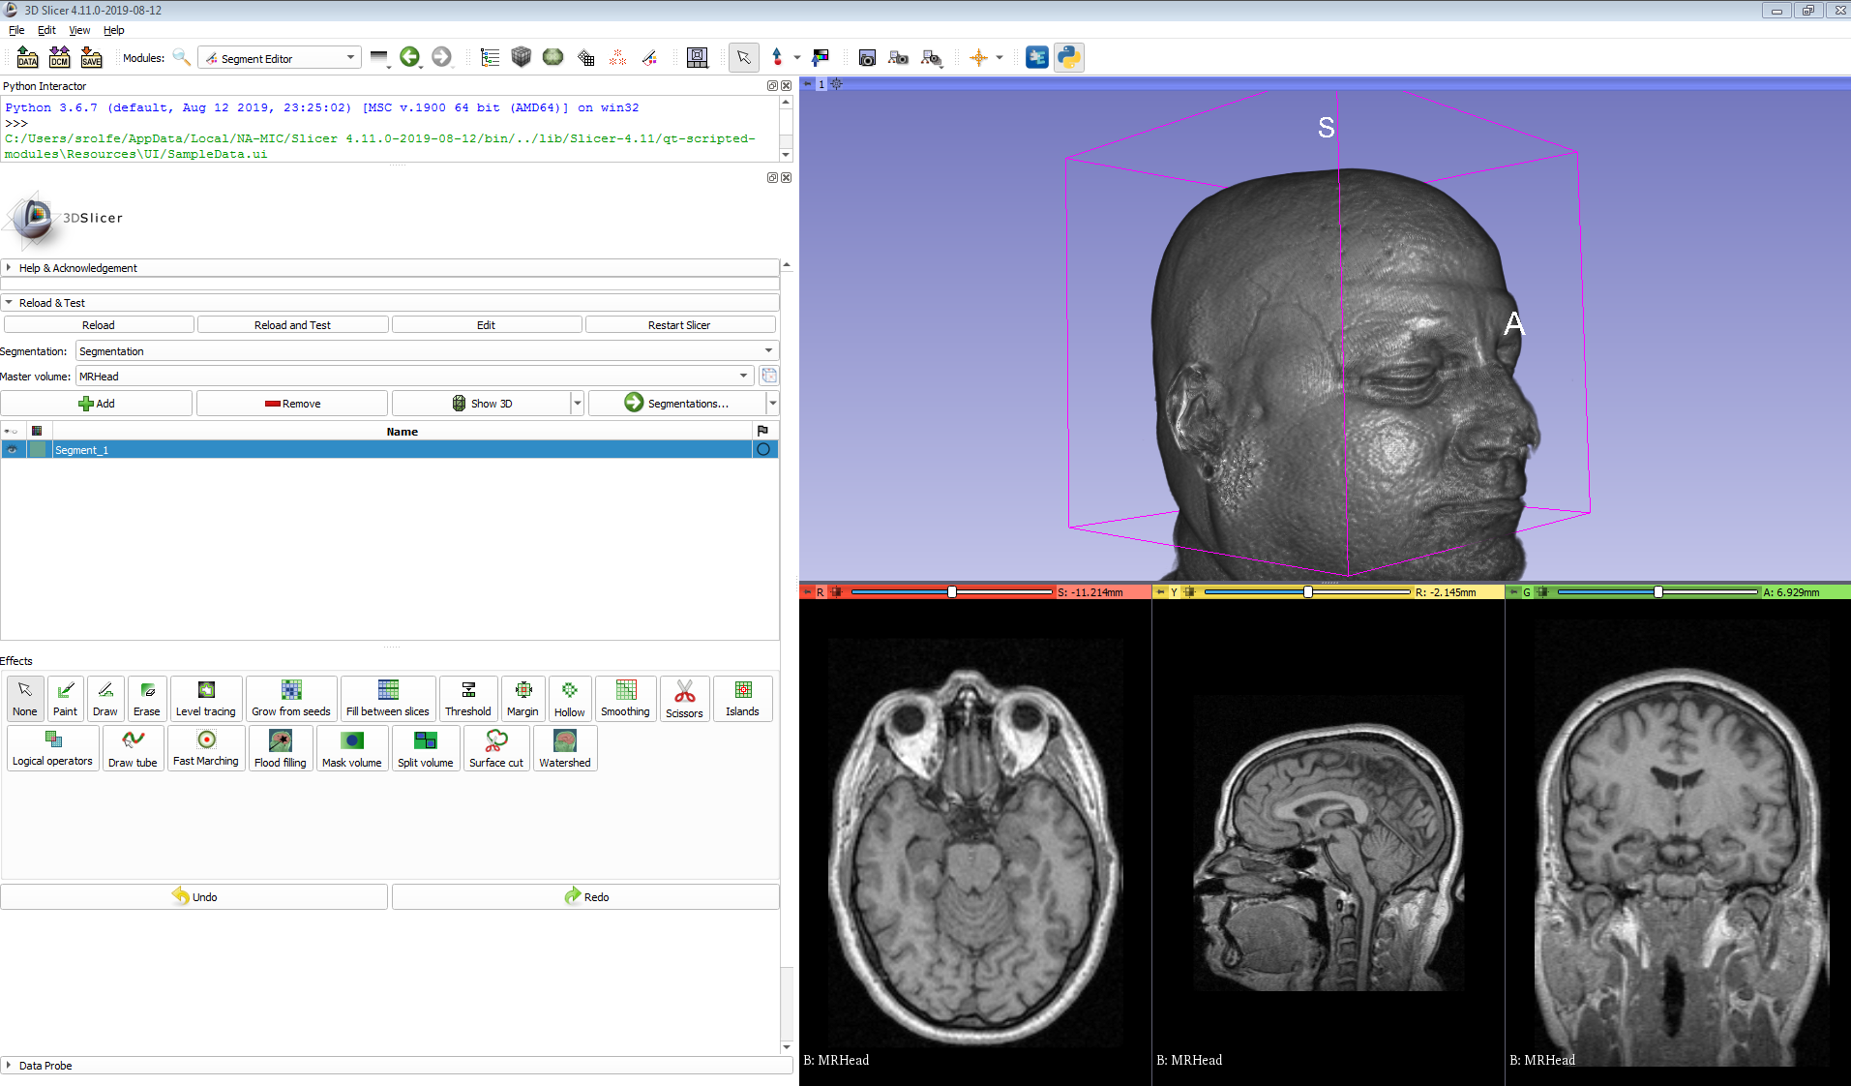
Segmentation tools available in 3D Slicer

Slide 48
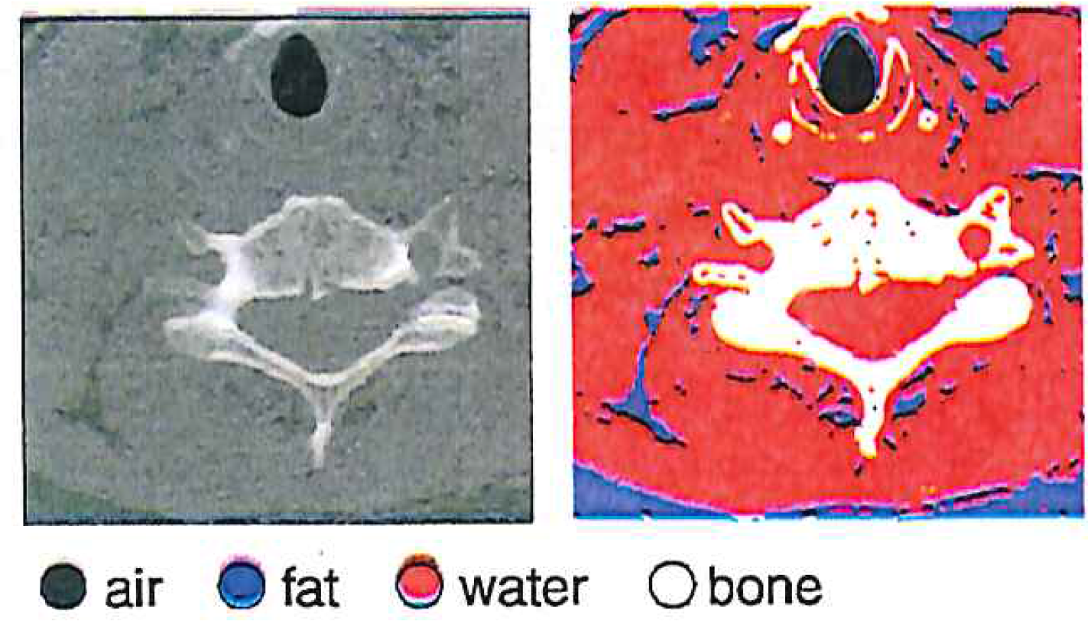
Thresholding
Assigning labels to pixel intensity ranges
Can be static or dynamic
Static: known value ranges for types of tissue in CT scans
Segmentation in CT relying on Hounsfield Units (HU) which define a window of values for each tissue type

Slide 49
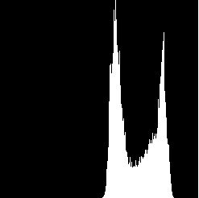
Histogram-Directed Thresholding
How can we use a histogram to separate an
image into 2 (or several) different regions?
pixel
counts
0
256
gray-tone values
Is there a single clear threshold? 2? 3?

Slide 50
Automatic Thresholding: Otsu’s Method
Grp 1 Grp 2
Assumption: the histogram is bimodal
Method: find the threshold t that minimizes
the weighted sum of within-group variances
for the two groups that result from separating
the gray tones at value t.
Note: In practice, this operator works very well for true bimodal
distributions and not too badly for others.

Slide 51
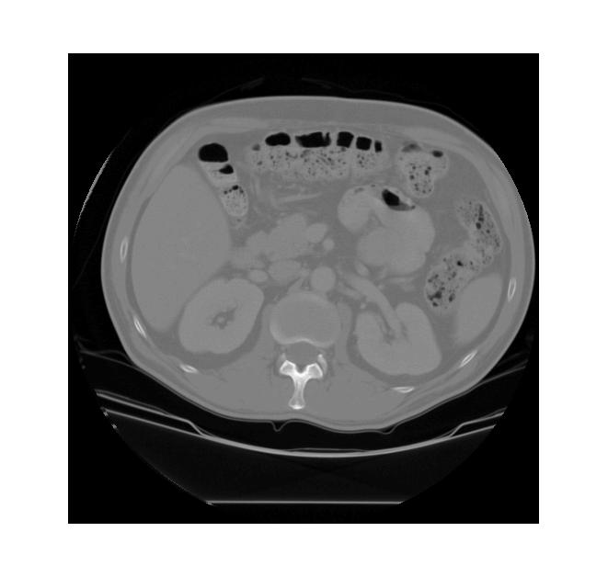
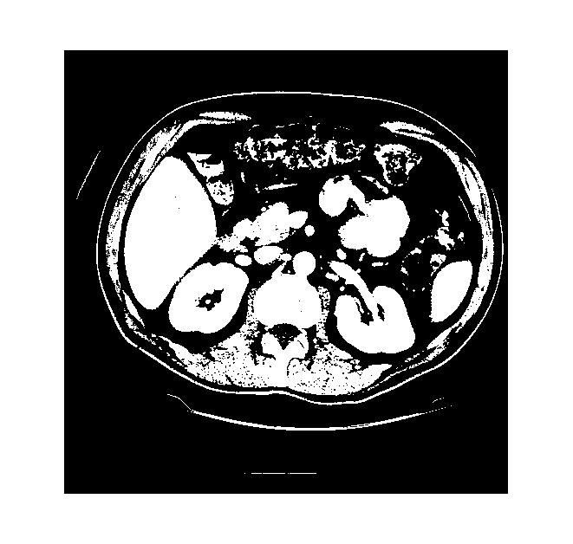
Thresholding Example
original gray tone image
Binary image after threshold is applied

Slide 52


Connected Components Labeling
Identify and then analyze each connected set of pixels.
The connected components operation takes in a binary image and produces a labeled image in which each pixel has the integer label of either the background (0) or a component.
original grayscale image
binary image after threshold applied
binary image after morphology
connected components

Slide 53
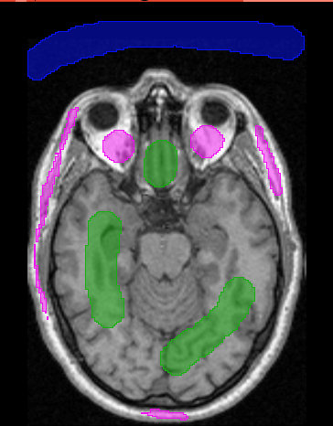
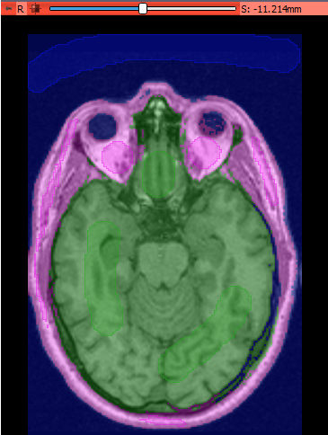
Grow from seeds
Region growing techniques start with one pixel of a potential region and try to grow it by adding adjacent pixels till the pixels being compared are too dissimilar
Can include a priori knowledge of the scene by taking a set of seed pixels can be chosen from the image
A statistical tests used to decide which pixels can be added to a region
User provided seeds
Segmentation grown from seeds

Slide 54
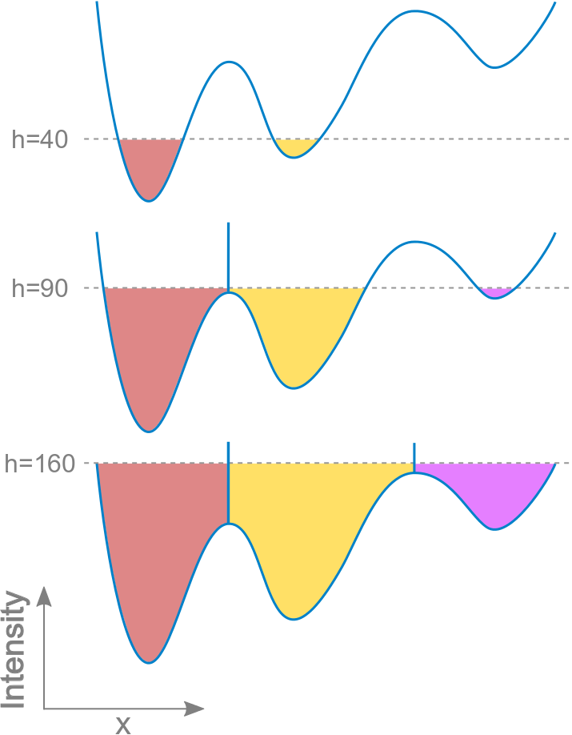
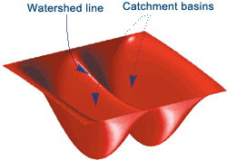
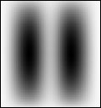
Watershed filtering
The watershed transform treats a 2D image like a surface
Catchment basins are identified at regional minimums
The basins are “flooded” until the different water sources meet, determining the watershed lines between regions
Gray scale image
Image visualized as a surface where bright areas are “high” and dark are “low”
Progressive watershed “flooding” in 1D

Slide 55
Visualization
All transforms that optimize the output of the image to create a realistic depiction of 3D data
Surface-based
Fast marching filter
Surface rendering
Direct volume visualization
Ray casting

Slide 56
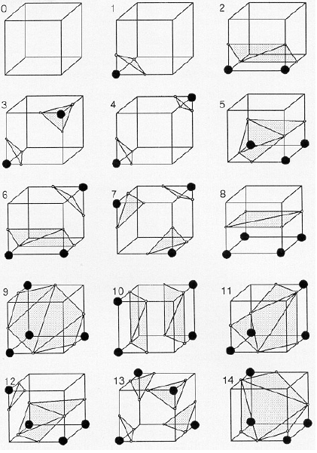
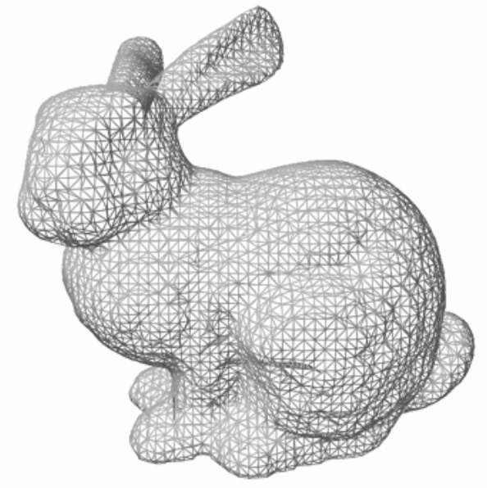
Fast marching filter
Developed to reconstruct surfaces from medical images
Each voxel is considered as a point, instead of a 3D voxel
Create a cube with 8 pixels on adjacent slices. Move the cube to each point in the image to determine if the vertices are “in” or “out”
15 distinct topologies can be stored in a lookup table for efficiency

Slide 57
Surface rendering
Create photo-realistic representations of volume surfaces
Lighting modeled by constant ambient light overlapped with reflections based on the material properties of the surface
Takes into account translucency, surface texture, and reflections

Slide 58
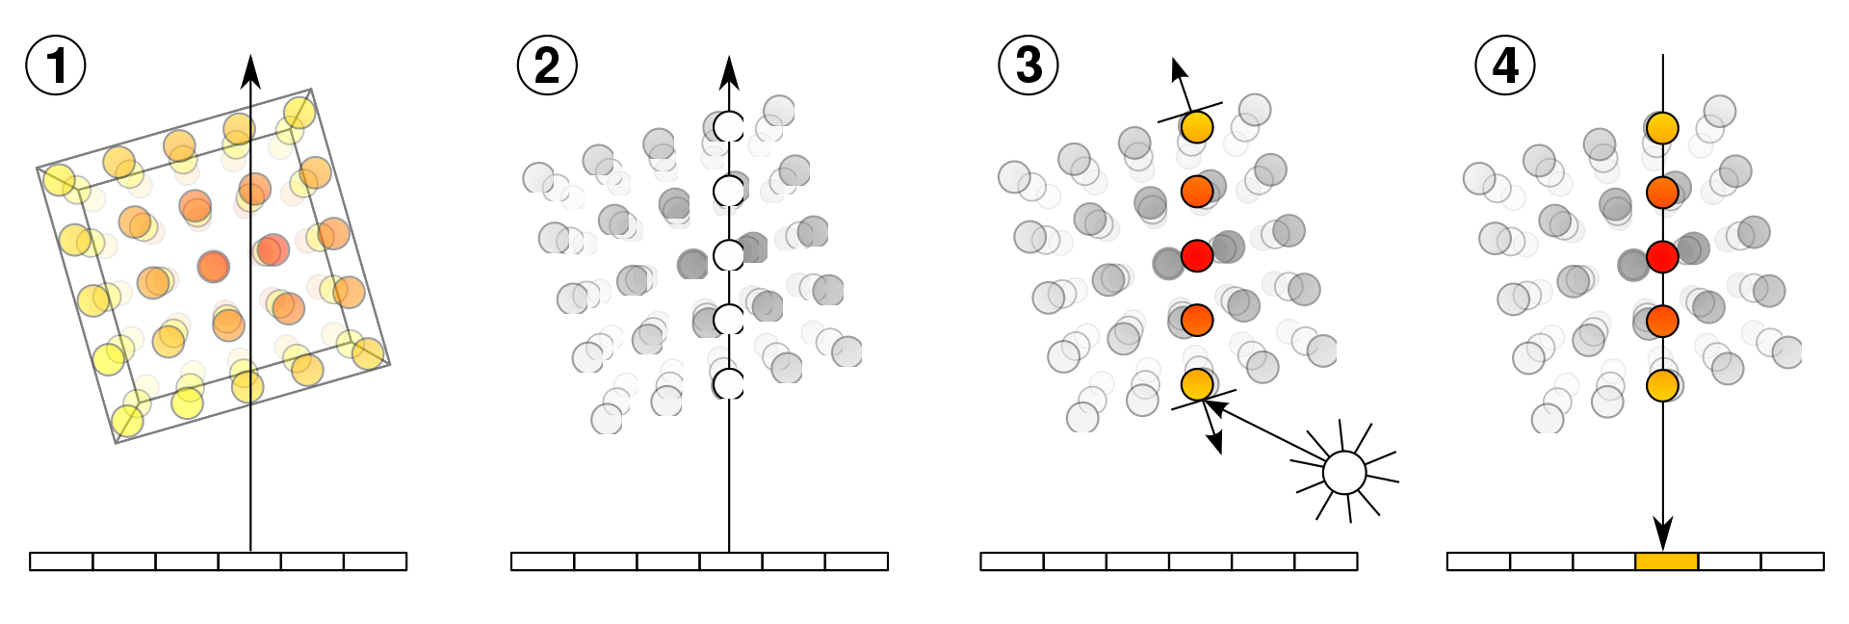
Volume rendering: Ray casting
Direct volume visualization does not rely on a preliminary calculation of the object surface or segmentation
Visualization based directly on voxel data
1. Volume is processed along an imaginary light ray
Parameters are extracted from voxel intensity along the rays and
A transfer function is applied that incorporates material properties and illumination
The final value is applied as color or gray values at the corresponding position on the viewing plane

Slide 59
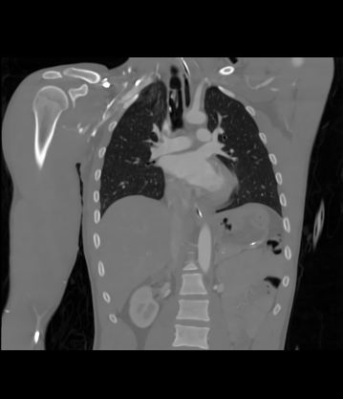
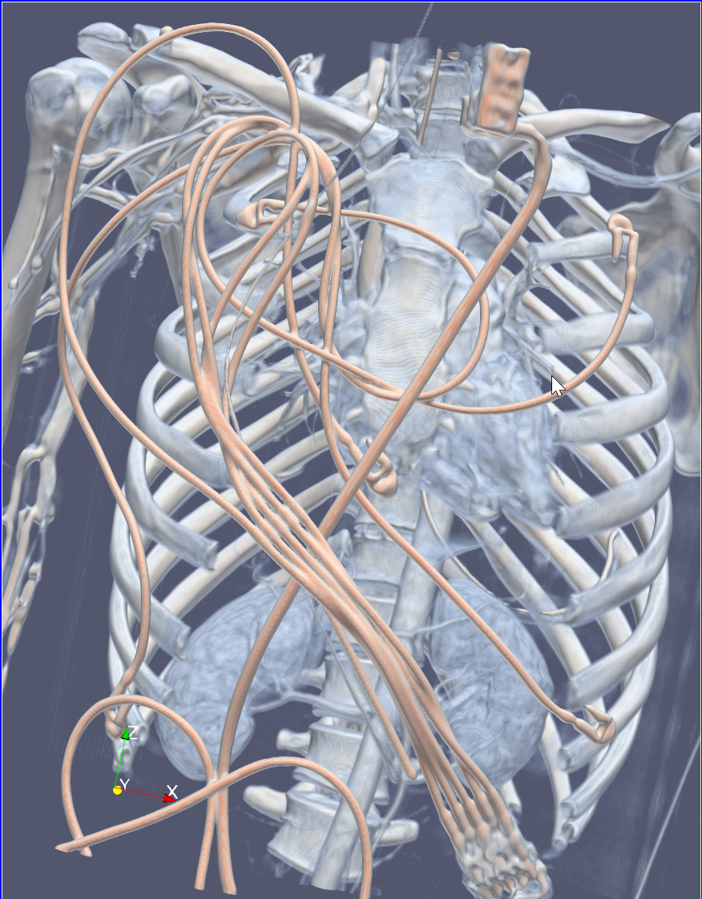
GPU Ray casting
Coronal slice of 3D CTA image
3D volume rendering using ray casting

Slide 60
Resources
Free online texts
Deserno, Thomas Martin. "Biomedical image processing." (2011). Available at this URL
Shapiro and Stockman, Computer Vision, Prentice-Hall, 2001. Original chapters available at this URL
Szeliski, Richard. Computer vision: algorithms and applications. Springer Science & Business Media, 2010. Available at this URL
Online lectures
Noah Snavely's CS5670 - Introduction to Computer Vision class at Cornell Tech (Spring 2019)
Ioannis Gkioulekas's 16-385 Computer Vision class at CMU (Spring 2019)
Coordinate systems
Chand John of Stanford created adetailed powerpoint presentation about the way coordinates are handled in Slicer
Rendering
Udupa, Jayaram K., Hsiu-Mei Hung, and Keh-Shih Chuang. "Surface and volume rendering in three-dimensional imaging: a comparison." Journal of digital Imaging 4.3 (1991): 159.

Slide 61
Questions?

